Slide 1


Team 16: Solar Power Battery
Bi-Weekly Update 3 Lauren Lugo, Tarik Dawson, Clement Ong, Nathan Gil Sponsor: Peng-Hao Huang TA: Dalton W. Cyr
Notes:
Michelle

Slide 2
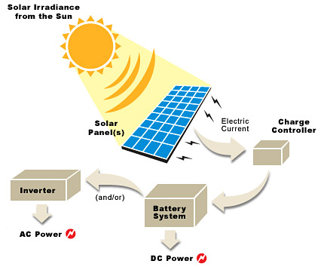
Project Summary
Problem Statement:
Recently there has been a shift and demand in renewable energy
Problem is it is hard to access remotely / not movable
Solution proposal:
Develop independent power grid using a solar panel that can charge the majority of items throughout the day and night.
Notes:
Kyle

Slide 3
Integrated System Diagram
PCB Enclosure
DC-DC
DC-AC
AC Output
External Solar Panel
Input Ports
DC Output
Battery Switch
Battery connection
Microcontroller
Usb Port
Device
Battery
Notes:
Eric

Slide 4
Project Timeline
(Complete)
(Complete)
(Ongoing)
(Not Started)
(Not Started)
Jan 18th - Feb 1st
Feb 2nd - Feb 28th
March 1st - April 7th
April 7th - April 21st
April 21st - April 28th
Finalize Subsystems
Validate Individual Subsystems
Integration Between Subsystems
Validate System
Final Demo
Team members have finalized their designs and making finishing touches on subsystem
Team will finalize and validate individual subsystems
ESP32 and Database is undergoing integration for bi-direction communication. Sensors/switches undergoing integration between DC-DC and ESP32.
Team will validate entire system to ensure accuracy and functionality
Team will demo the final completed system
Notes:
Eric

Slide 5
MPPT
Accomplishments since last update 15 hrs of effort | Ongoing progress/problems and plans until the next presentation
Completed integrating sensors/switches with DC-DC Converter | Cleaning up code between Microcontroller and Database Get Microcontroller up PCB and running Validate integrated system with solar panel

Slide 6
DC-DC Converter
Tarik Dawson
Accomplishments since last update 28 hrs of effort | Ongoing progress/problems and plans until the next presentation
Integrated subsystem testing complete. Design refined and updated. Switch fixed. Current Sensor problem fixed. System will now read current up to 60A. | Order updated board and parts Hook up new board and proceed with functional system tests. Perform “Test to failure” on old board verify if any other problems occur at higher currents.

Slide 7
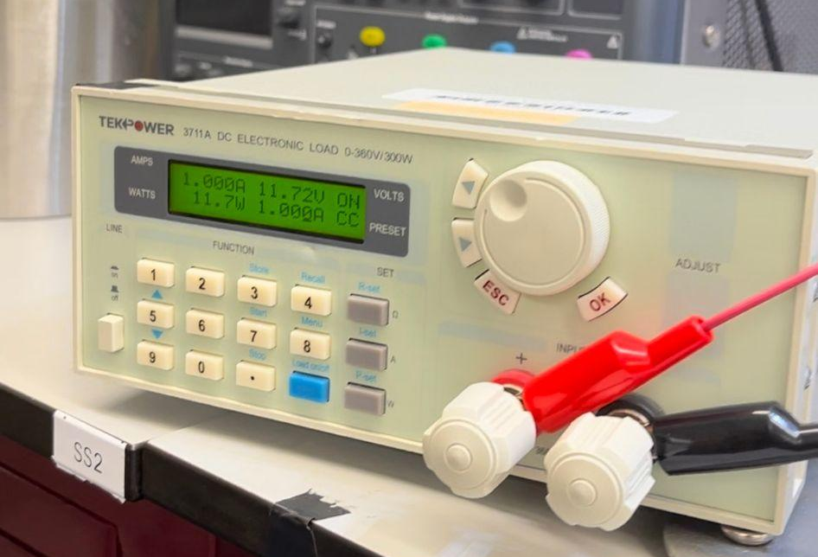
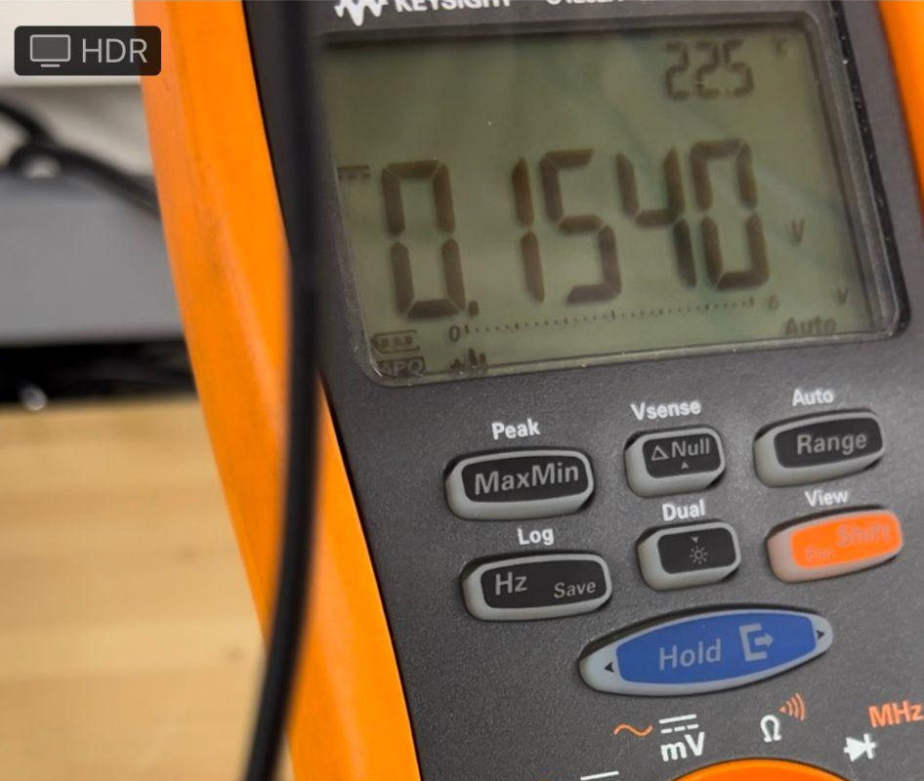
DC-DC converter
Testing Results: Switch
Switch performs as expected now.
Any signal from the microcontroller will control it
Testing Results: Current Sensors
Current Sensors work as intended on the DC-DC converter
Gain is too high. A solution is in place.

Slide 8
DC-AC Inverter
Clement Ong
Accomplishments since last update 14 hrs of effort | Ongoing progress/problems and plans until the next presentation
Deadband gap successfully implemented in PWM PCB fully soldered | Currently ongoing system testing and validation

Slide 9
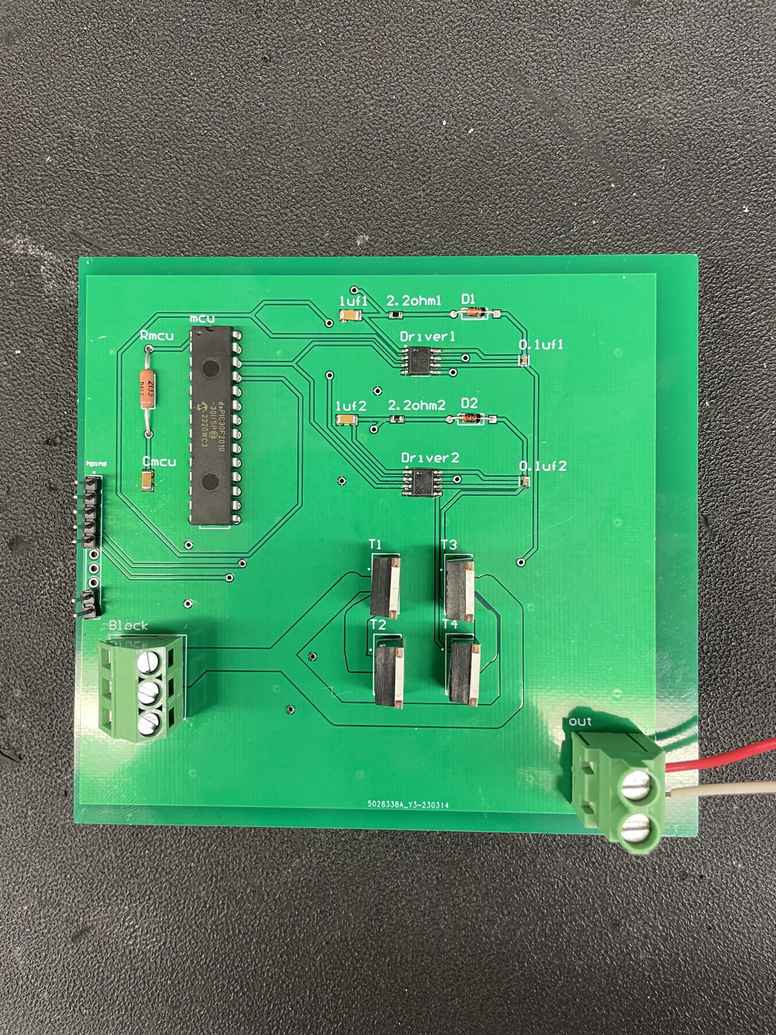
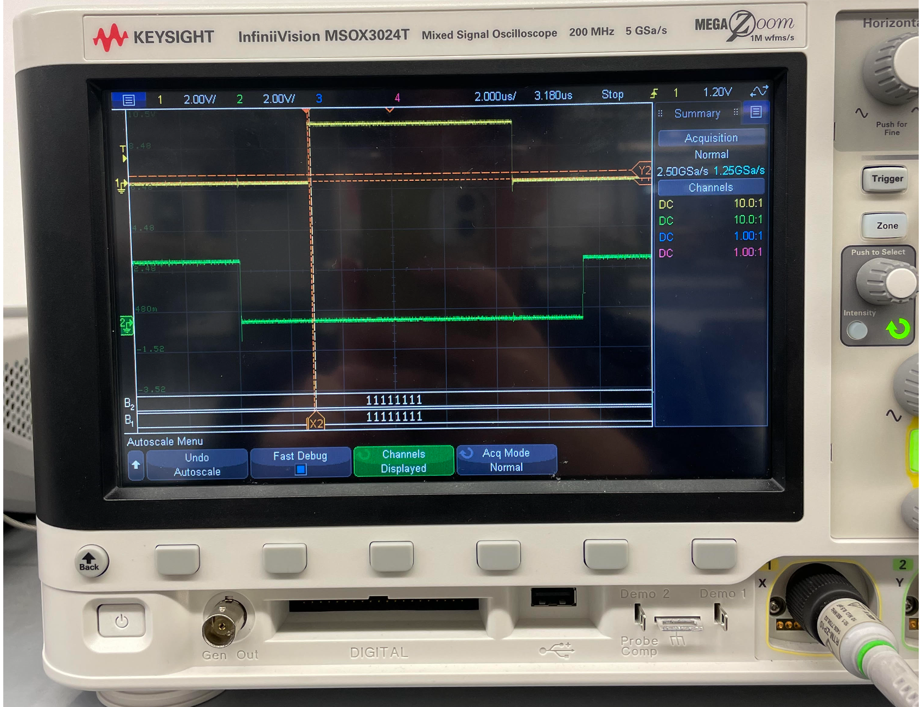
DC-AC Inverter

Slide 10
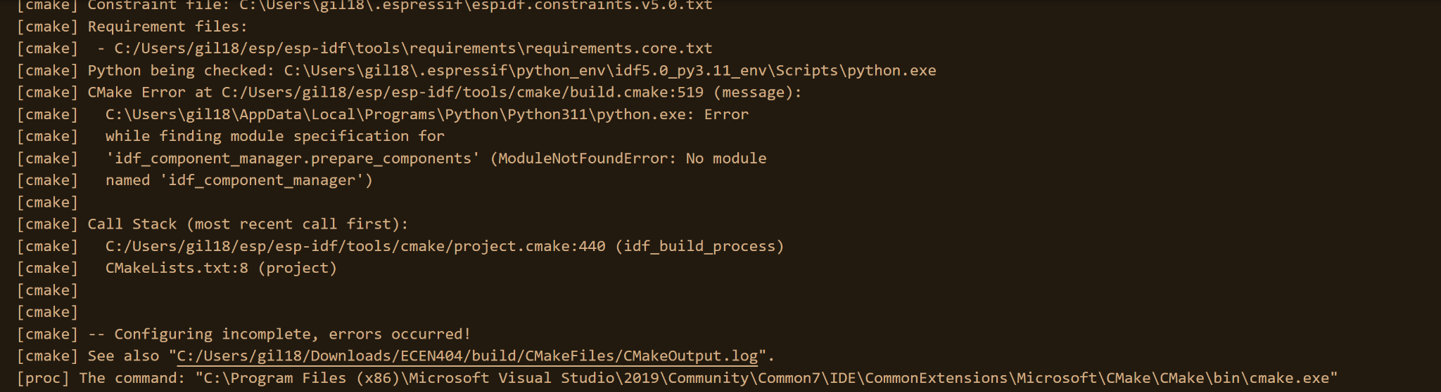
Website / Android Application
Nathan Gil
Accomplishments since last update 12 hrs of effort | Ongoing progress/problems and plans until the next presentation
N/A | Complete connecting my own ESP32 to backend (issues w/ CMake) *works for Lauren* Format data correctly to be organized in the backend Show data from ESP32 -> Backend -> Frontend

Slide 11
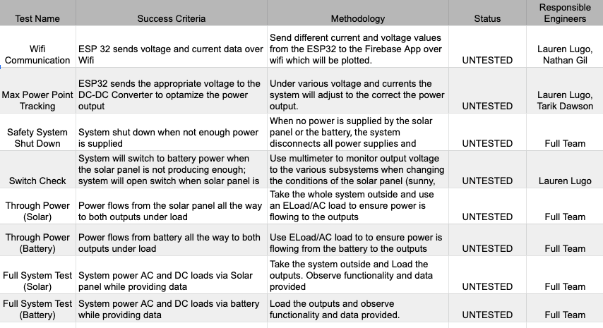
Validation Plan

Slide 12
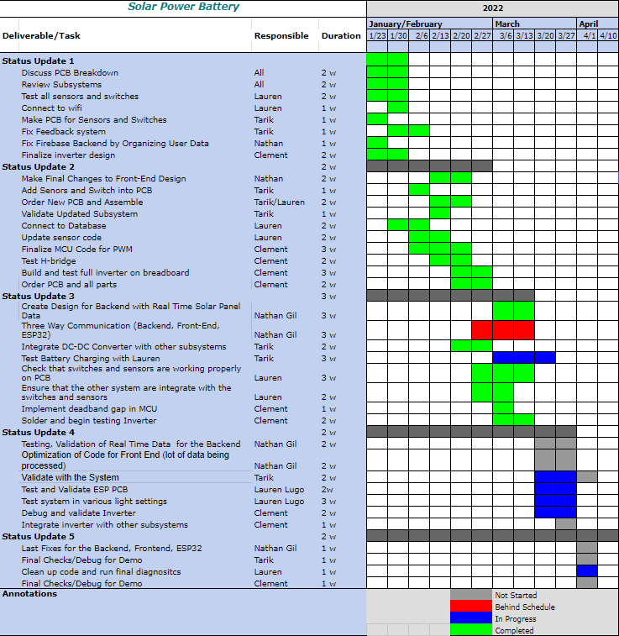
Execution Plan
Notes:
Michelle

Slide 13
Thank you for your attention!

